Slide 1
Analyzing the driving factors behind loan default
Hammam Rehan
Arsen Vardanian
Fiona Sauer
Jieun
Mohammad Nahle

Slide 2
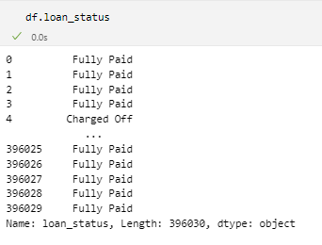
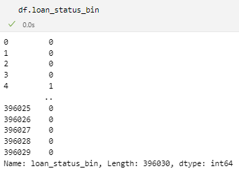
Goal: Identifying risky loan applicants by doing an analysis on the factors behind a loan default
We used the lending_club_loan_two dataset
We need to graphically analyze variables on default rate

Slide 3
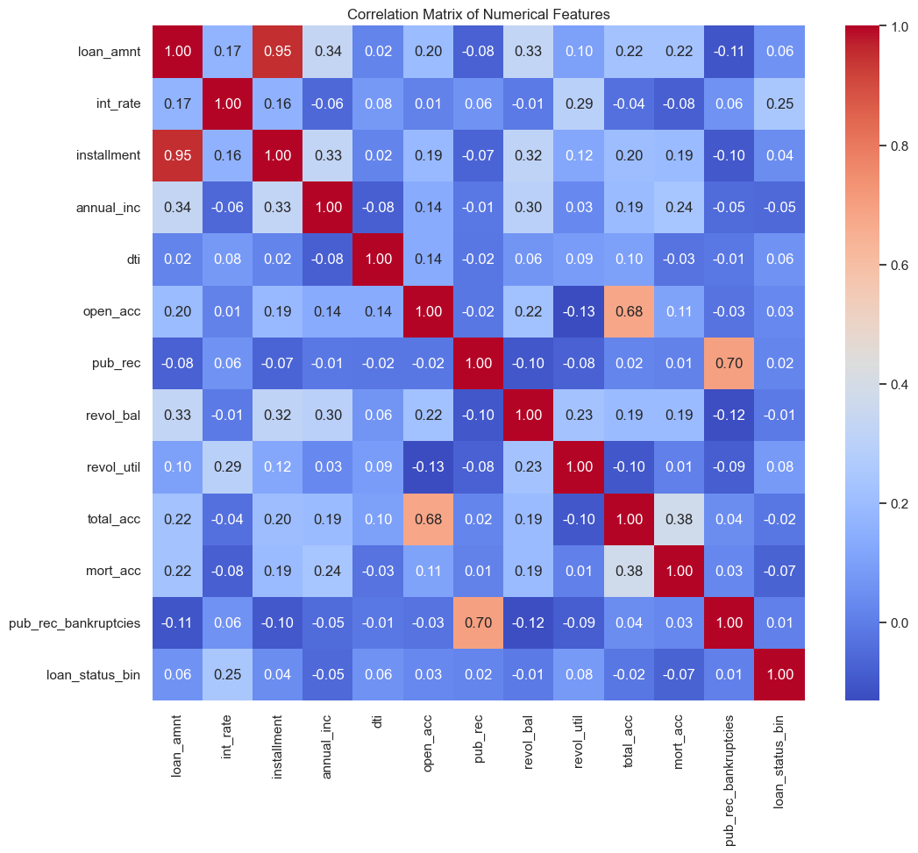

Slide 4
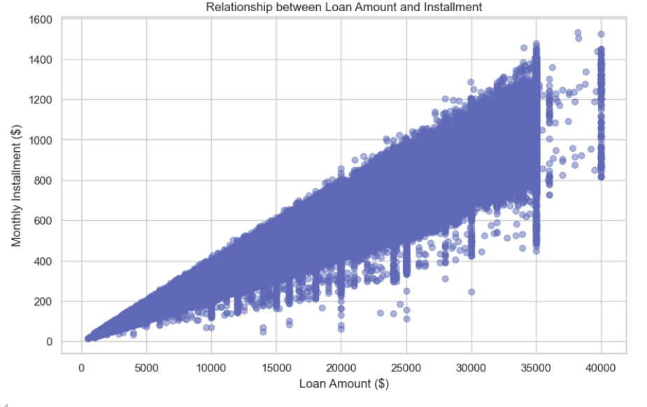
We noticed almost perfect correlation between "loan_amnt" the "installment" feature
clear linear pattern, this indicates a strong linear relationship, confirming the hypothesis about their correlation

Slide 5
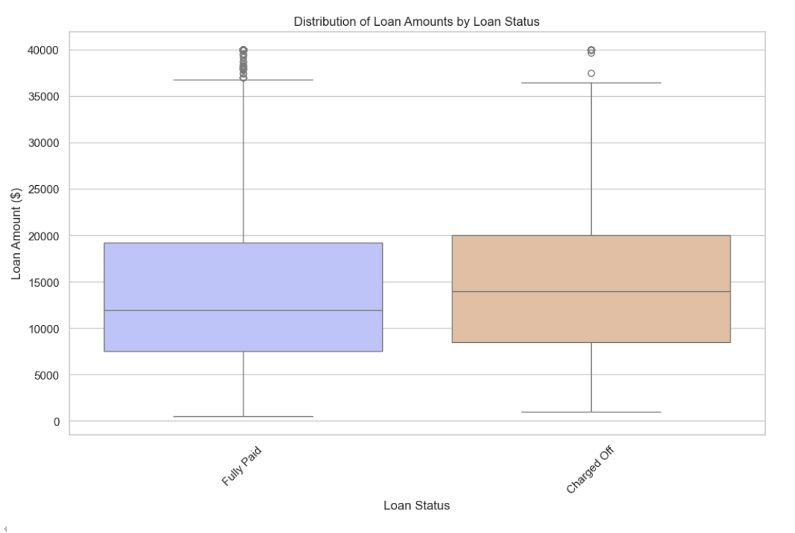
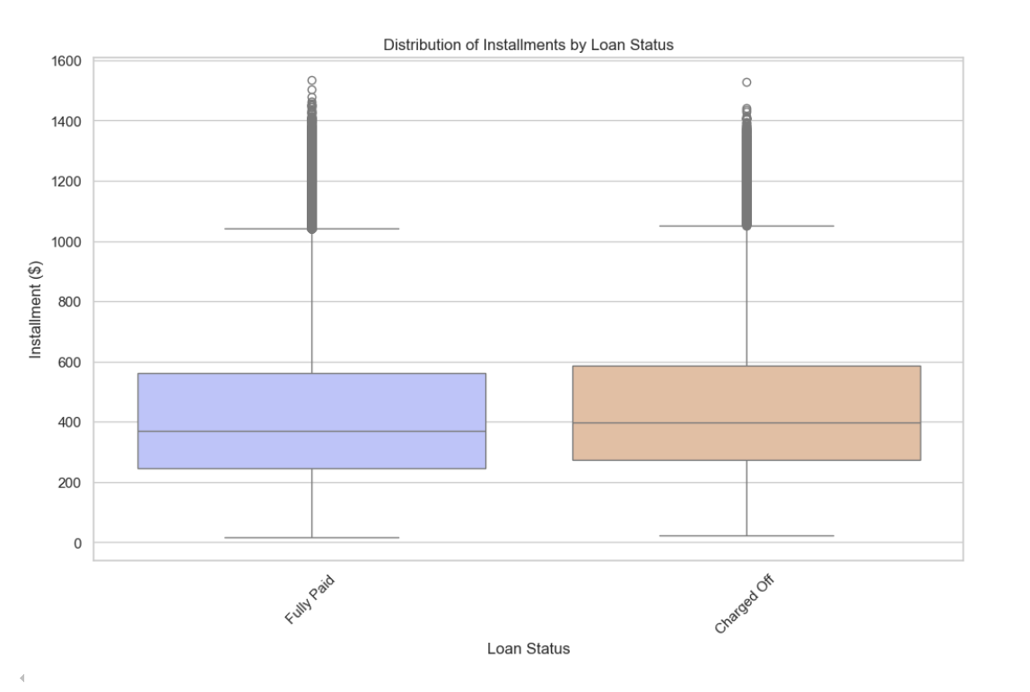
Higher median loan amounts in the charged-off category could imply that larger loans carry a higher risk of default.
There are numerous outliers above the upper whisker, suggesting that while most fully paid loans are lower, there are significant exceptions with very high loan amounts
higher median installment for loans that are charged off (defaulted) compared to those that are fully paid
There are numerous outliers above the upper whisker, suggesting that there are significant exceptions with very high installment amounts.

Slide 6
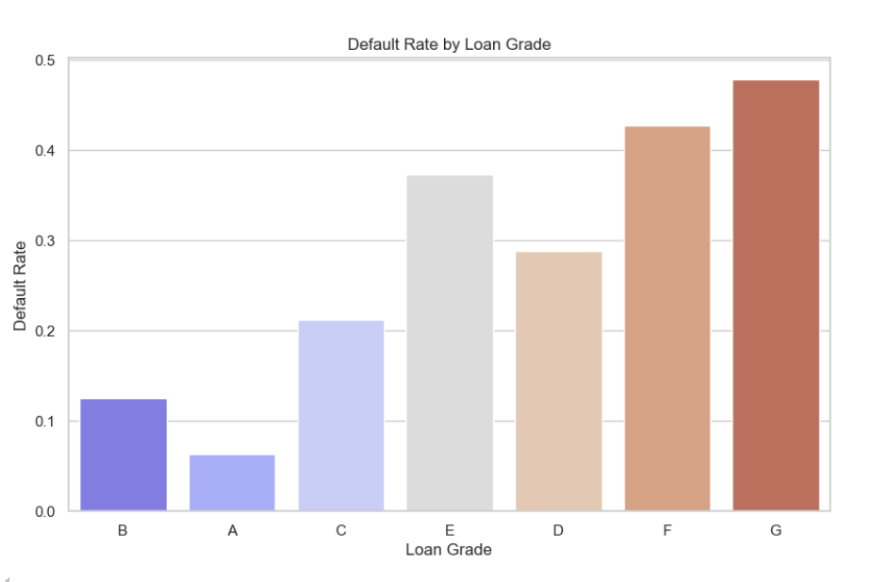
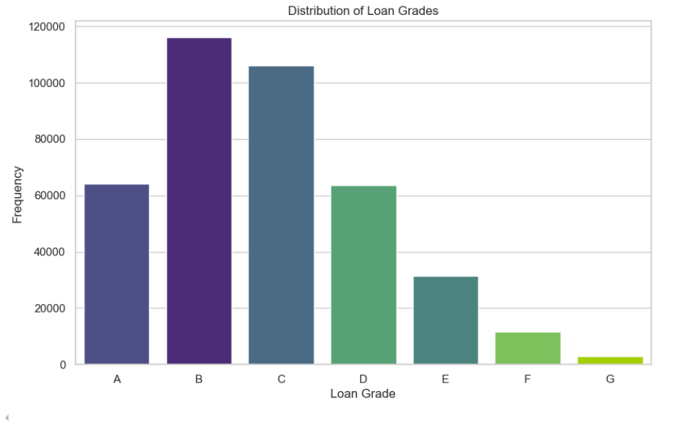
Loan Grades and default rates

Slide 7
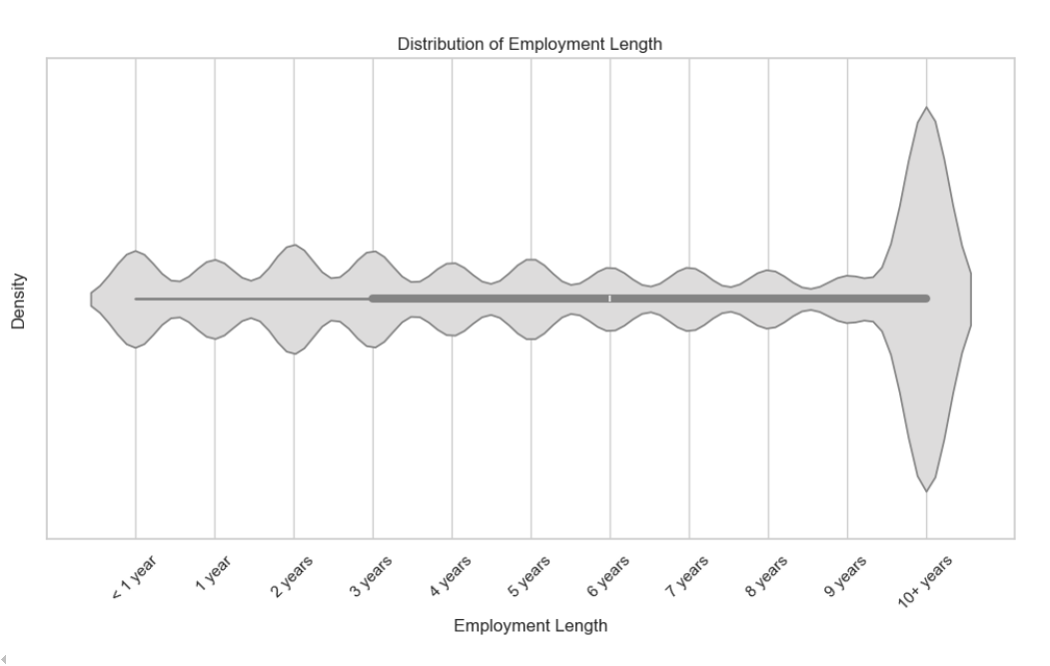
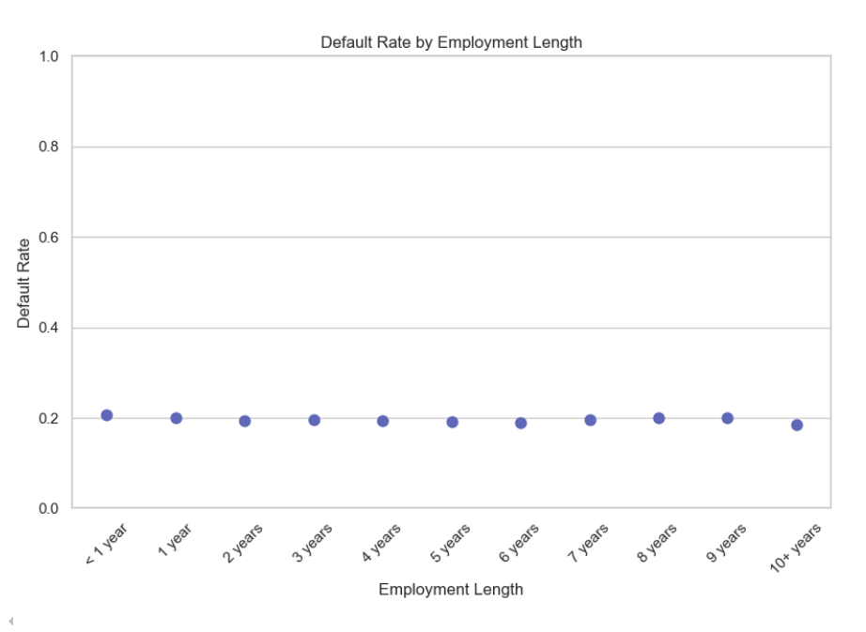
Employment Length and Default rate

Slide 8
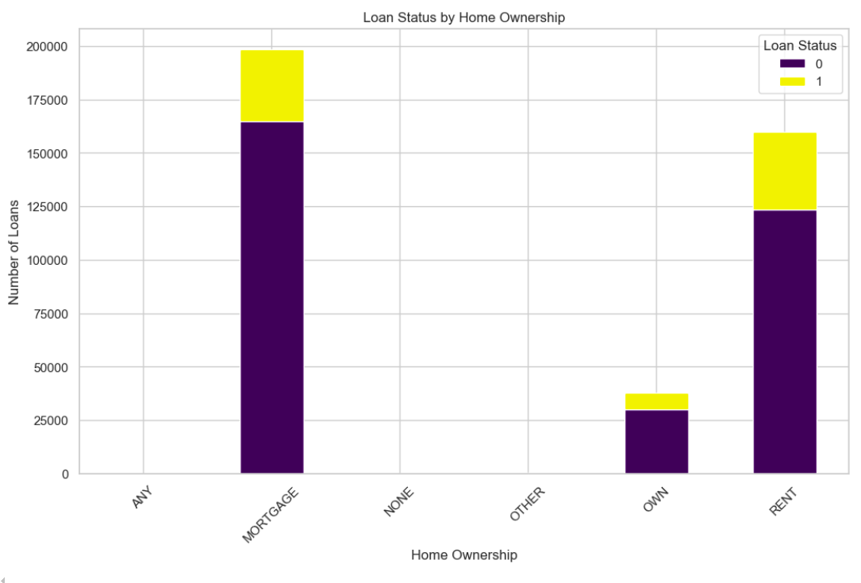
Home Ownership and Default rate
0 is fully paid
1 is charged off
Mortgage and Rent categories show both significant loan counts and noticeable default segments

Slide 9
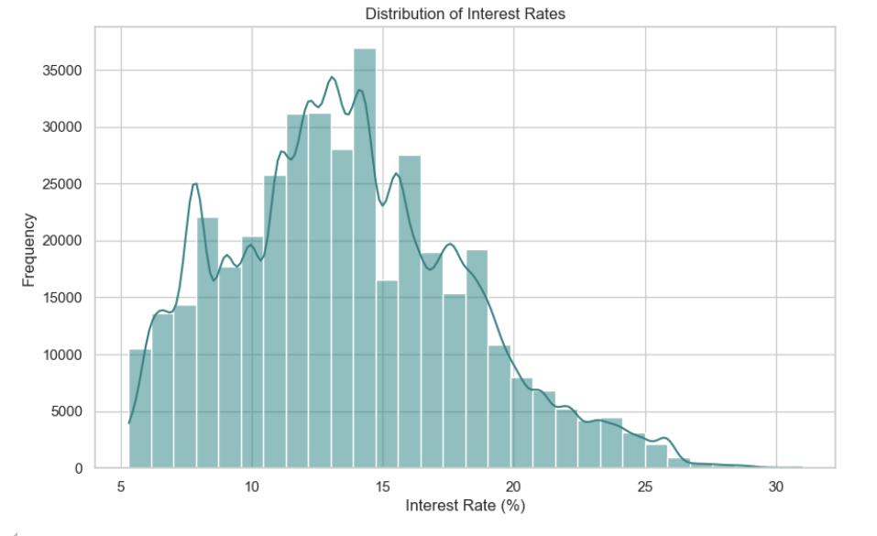
Distribution of Interest Rates

Slide 10
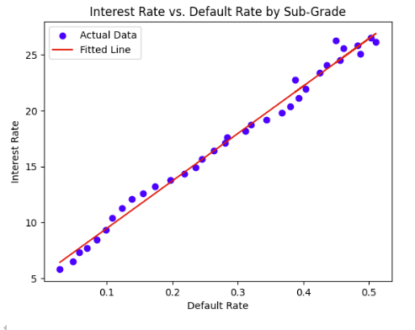
Describing the linear connection between default rate and interest rate using linear regression
Risk Compensation
The large slope indicates that the interest rate is highly responsive to changes in perceived risk, which is consistent with how financial institutions manage their exposure to potential losses.
Lenders often charge higher rates to riskier borrowers to compensate for the greater risk of loan default.
interest rate = 5.216621308807113 + 42.43980704484836 * default rate
The positive coefficient for the default rate suggests a direct relationship between risk (default rate) and the price of borrowing (interest rate).
for every 1% increase in the default rate, the interest rate increases by about 42.43 percentage points. This indicates a strong sensitivity of interest rates to changes in the default rate

Slide 11
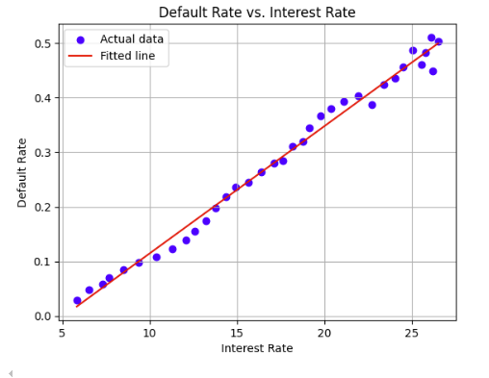
Describing the linear connection between default rate and interest rate using linear regression
Financial Burden
The positive relationship is logical and aligns with financial principles, higher interest rates often correlate with higher default risks as they can increase the financial burden on borrowers, potentially leading them to default.
Default rate = -0.1186 + 0.0233 * interest rate
for each 1% increase in the interest rate, the default rate increases by 0.0233, or 2.33 percentage points.

Slide 12
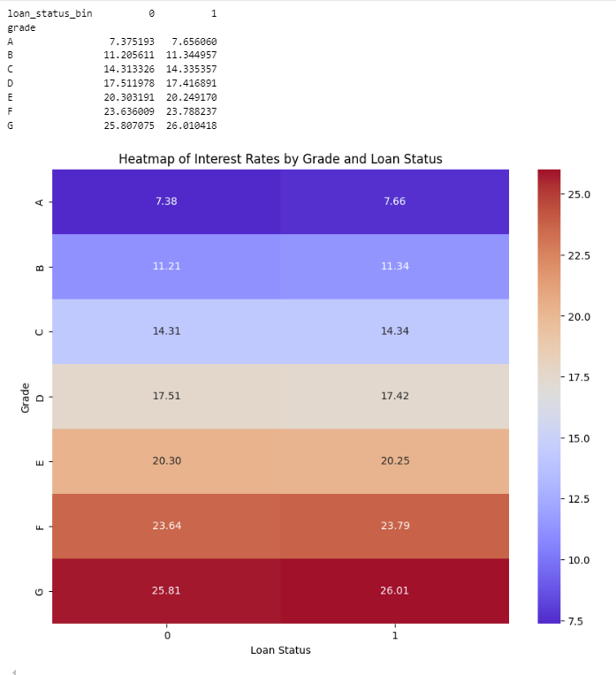
Heatmap of IR, Grade, and Loan Status
There's a clear trend showing increasing interest rates as grades go from A to G. This pattern is consistent across both loan status categories, which is typical as lower grade loans are perceived as higher risk and thus result in higher interest rates to compensate for that risk.
Color Intensity: The colors range from blue to red, with blue indicating lower interest rates and red indicating higher interest rates.
0 is fully paid, 1 is charged off

Slide 13
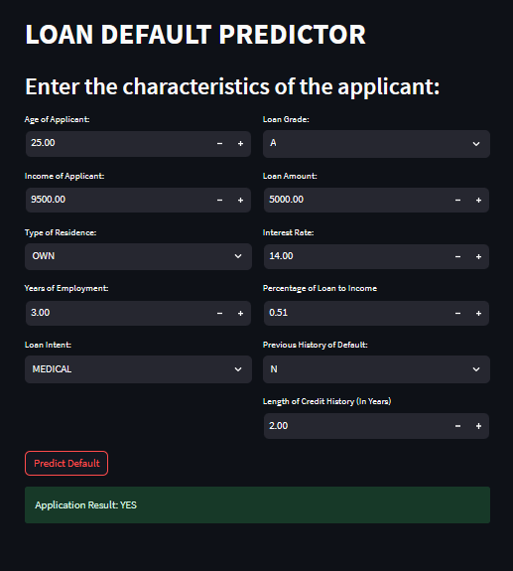
We notice that there are two types of features:
Features related to the applicant (occupation, employment details etc.),
Features related to loan characteristics (amount of loan, interest rate, purpose of loan etc.)
Building The Model:
1- Choose the variables
2- Make sure there are no missing data / string data (dummy variables possibly)
3- Split Data into test data and train data
4- Build the model according to either Logistic Regression or RandomForest (show ROC curve)
5- Find the features that affect Loan_status the most
6- Optional: build a small program that is able to predict loan default

